Slide 1
Topics
Architecture
Controls
Data Binding
State Management

Slide 2
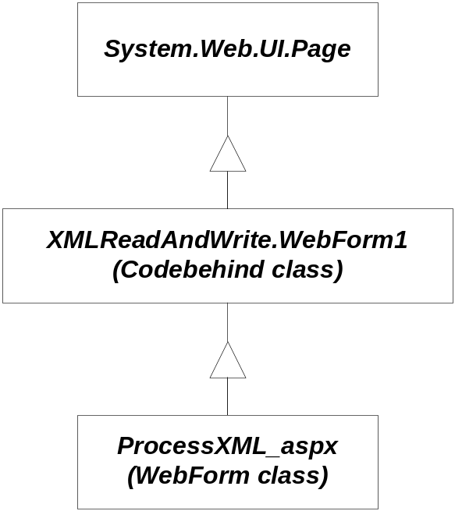
Architecture
ASP application
  ProcessXML.aspx
  ProcessXML.aspx.cs
  Web.config
Page Class
  MapPath()
  Application
  ContentType
  Context
  IsPostBack
  Request
  Response
  Server
  Session
  Trace
  User
  …
ProcessXML_aspx
  Page_Load(Object, System.EventArgs)
  Button1_Click(Object, System.EventArgs)
  InitializeComponent()
  …

Slide 3
Page Events
public event EventHandler Init;
Page_Init(object,EventArgs)
public event EventHandler Load;
Page_Load(object,EventArgs)
public event EventHandler PreRender;
Page_PreRender(object,EventArgs)
public event EventHandler Unload;
Page_Unload(object,Eventargs)
protected virtual void
OnInit(EventArgs e);
protected virtual void
OnLoad(EventArgs e);
protected virtual void
OnPreRender(EventArgs e);
protected virtual void
OnUnload(EventArgs e);

Slide 4
ASP.Net Directives
@Page
  Defines Language and Code-Behind file
@Import Namespaces
  Equivalent to using directives
@Register
  Registers user controls with page. Page will call render on each of its registered controls.
@Implements
  Declares an interface this page implements
@Reference
  Specifies a page or user control that will be compiled and linked at run-time
@Assembly
  Links an assembly to the current page during compilation
Plus more – see help documentation

Slide 5
Page Attribures
CodeFile
  Specifies a path to a code-behind file for the page. Used with Inherits attribute.
Inherits
  Defines a code-behind class for the page to inherit.
AutoEventWireup
  If true, the default, simple event handlers are wired up automatically
Debug
  If true, code behind is compiled with debug symbols

Slide 6
ASP Components
You can create library assemblies that are available to every aspx page in your application.
  Compile the library dll assembly
  Place it in a bin directory under the application virtual directory
  It will then be implicitly referenced by any page that loads from the application directory
  You can copy over the dll with an update without stopping IIS.
    If you do this, the new version becomes available on the next page load.

Slide 7
Controls
HTML Controls
  HTML syntax
  runat=server attribute
  Derives from HtmlControl
  Instance created at server when page is constructed
Examples:
  <form runat=server>
  <img runat=server>
  <input type=file runat=server>
  <input type=radio runat=server>
Web Controls
  asp: prefix
  runat=server attribute
  Derives from WebControl
  Instance created at server when page is constructed
  Richer set of methods, properties, and events than HTML Controls
Examples:
  <asp:TextBox id=tb1 runat=server>
  <asp:Button Text=“Submit” runat=server>

Slide 8
Web Control Catalog
TextBox
Label
HyperLink
Image
CheckBox
RadioButton
Table – matrix addresses
Panel
Button
ListBox
DropDownList
CheckBoxList
RadioButtonList
Repeater – HTML template
DataList – HTML template
DataGrid – no longer in toolbox by default, but can be added
Calendar
Validation Controls
  RequiredField
  RegularExpression
  Range
  Compare
  Custom

Slide 9
Data Related Controls
Data Controls
  GridView
  DataList
  DetailsView
  FormView
  Repeater
  SqlDataSource
  ObjectDataSource
  XmlDataSource
  SiteMapDataSource
Validation Controls
  RequiredFieldValidator
  RangeValidator
  RegularExpressionValidator
  CompareValidator
  CustomValidator

Slide 10
More Controls
Navigation Controls
  SiteMapPath
  Menu
  TreeView
Login Controls
  Login
  LoginView
  PasswordRecovery
  LoginStatus
  LoginName
  ChangePassword
Webparts
  WebPartManager
  ProxyWebPartManager
  WebPartZone
  CatalogZone
  DeclarativeCatalogPart
  PageCatalogPart
  ImportCatalogPart
  EditorZone
  AppearanceEditorPart
  BehaviorEditorPart
  LayoutEditorPart
  PropertyGrideEditorPart
  ConnectionsZone

Slide 11
User Defined Controls
User controls are stored in ascx files.
They contain an @control directive that plays the same role as the @Page directive for WebForms.
  <%@ Control classname=“UserControlCS” %>
In an aspx file that uses the control:
  <%@ Register
  TagPrefix=“cse776” TagName=“IP” Src=“MyControl.ascx”
  %>
  <cse776:IP id=“myControl1” runat=“server” />
A user control may contain HTML and codebehind with methods, properties, and events.
Events are declared as delegates with the event qualifier

Slide 12
Data Binding
Data Binding provides an abstraction for loading a control with data provided by some collection.
The data is cached in the control until it is rendered on the client’s page by putting it onto the response buffer, formatted according to the control’s policy.
We have already seen an example of binding an HTML table to an XML file, in Lecture #2.
Binding is often used when an ASP application connects to a database through a DataReader or DataSet.

Slide 13
Data Binding
Controls that Support Data Binding must expose:
  a property called DataSource
  a method called DataBind()
The data source must provide:
  IEnumerable interface
Example:
DataSet ds = new DataSet();
ds.ReadXML(Server.MapPath(“test.xml”);
ListBox1.DataSource = ds;
ListBox1.DataTextField = “file”; // omit if flat
ListBox1.DataBind();

Slide 14
Data Binding
Data Binding Controls
  HtmlSelect
  CheckBoxList
  DataGrid
  DataList
  Repeater
  DropDownList
  ListBox
  RadioButtonList
Data Sources
  Array
  ArrayList
  HashTable
  Queue
  SortedList
  Stack
  StringCollection
  DataView
  DataTable
  DataSet
  IDataReader
  Classes that implement IEnumerable

Slide 15
State Management
Adding user state inherently reduces scalability.
  So if you are trying to provide a resource that handles a large volume of traffic, you will want to minimize use of state.
Types of state
  Application:
  Shared across all clients of this application
  Session:
  Per client state persistent over page boundaries. Requires cookies or URL mangling to manage client association.
  Cookie:
  Per client state stored on client. Clients can disable cookies.
  ViewState:
  Shared across post requests to the same page. Sent back and forth with each request.

Slide 16
Application State
In Global.asax: (add new item/Global Application Class)
void Application_Start(object src, EventArgs e)
{
DataSet ds = new DataSet(); // populated by clients
Application[“SharedDataSet”] = ds;
}
In Application Page:
private void Page_Load(object src, EventArgs e)
{
DataSet ds = (DataSet)(Application[“SharedDataSet”]);
// client interacts with DataSet
}

Slide 17
Session State
By default session state is managed in the same process and application domain as the application so you can store any data in session state directly.
Session state is available as a property of both Page and HttpContext classes.
It is:
  Initialized in Global.asax
  Accessed in any member function of the Page.
You specify whether you want session ids managed as cookies or URL mangling in the web.config file:
<configuration>
<system.web>
<sessionState cookieless=“true” />
</system.web>
</configuration>

Slide 18
Session State
In Global.asax:
void Session_Start(object src, EventArgs e)
{
DataSet ds = new DataSet(); // populated by clients
Session[“myDataSet”] = ds;
}
In Application Page:
private void Page_Load(object src, EventArgs e)
{
DataSet ds = (DataSet)(Session[“myDataSet”]);
// client interacts with DataSet
}

Slide 19
Cookies
Protected void Page_Load(Object sender, EventArgs e)
{
int age = 0;
if(Request.Cookies[“Age”] == null)
HttpCookie ac = new HttpCookie(“Age”);
ac.Value = ageTextBox.Text;
Response.Cookies.Add(ac);
age = Convert.ToInt32(ageTextBox.Text);
}
else
{
age = Convert.ToInt32(Request.Cookies[“Age”].Value);
}
// use age
}

Slide 20
ViewState
ViewState is used by ASP controls to transfer control state back and forth between server and client.
You also can use ViewState to transfer application state:
private void Page_Load(Object sender, EventArgs e)
{
ArrayLIst cart = (ArrayList)ViewState[“Cart”];
if(cart == null)
{
cart = new ArrayList();
ViewState[“Cart”] = cart;
}
}
// use cart with:
ArrayList cart = (ArrayList)ViewState[“Cart”];
cart… yada, yada, yada

Slide 21
Using Validation Controls (Page 1)
Compare controls, or part of the controls such as the data, to a rule
  Rule may require that the control contain any value, or require a specific form of data such as alphabetical or numeric.
  The rule may specify what the data must be contained within a range of two values.
  The rule may be very specific and require formatting such as uppercase letters and periods.

Slide 22
Using Validation Controls (Page 2)
The five validation controls are:
  RequiredFieldValidator—Makes sure a form field is not left blank
  RangeValidator—Makes sure a field’s value falls between a given range
  CompareValidator—Compares field with other values or values of other controls using relational operators
  RegularExpressionValidator—Evaluates the data against a regular expression
  CustomValidator—Evaluates data against custom criteria as defined in a programmer-define Function

Slide 23
Using Validation Controls (Page 3)
Inherits from the BaseValidator class which inherits from the Label class
  Therefore custom error messages are displayed using Label controls
Validation controls that perform comparisons inherit directly from BaseCompareValidator base class

Slide 24
Using Validation Controls (Page 4)
Common properties
  Display property—shows the message
    Dynamic—space for the validation message is dynamically added to the page only if validation fails
    Static—space for the validation message is allocated in the page layout whether there is an error, or not
    None—validation message is never displayed in the browser
  ErrorMessage—displayed if the value of the control is in error (extends from Text property of a Label)
  ForeColor property is the color of the error message (default color is red)

Slide 25
Using Validation Controls (Page 5)
Validate method performs validation on associated input control and updates the IsValid property
  Page.IsValid (Boolean) indicates if the controls on the page are valid after the Page.Validate method executes
The following checks if the entire form is valid
  Page.Validate()
  If Page.IsValid Then
  Message.Text = "Result: Valid!"
  Else
  Message.Text = "Result: Not valid!"
  End If

Slide 26
Using Validation Controls (Page 6)
ControlToValidate property specifies the control to validate
For the RegularExpressionValidator control, theValidationExpression property compares control to the regular expression
  Regular Expression is a rule that describes the value using a language that describes one or more groups of characters

Slide 27
Using Validation Controls (Page 7)
The ValidationExpression property
  Built-in regular expressions
  Regular Expression Editor
  Library of sample codes
    Internet E-Mail Address
    \w+([-+.]\w+)*@\w+([-.]\w+)*\.\w+([-.]\w+)*
    Internet URL
    http://([\w-]+\.)+[\w-]+(/[\w- ./?%&=]*)?
    US Phone Number
    \d{3}-\d{3}-\d{4}
    US Zip Code
    \d{5}(-\d{4})?

Slide 28
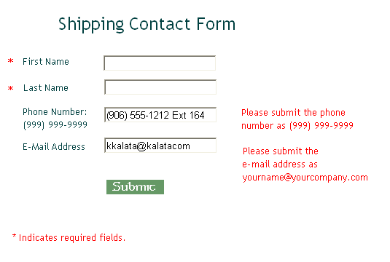
ASPValidateForm.aspx

Slide 29
Using Validation Controls (Page 8)
The ValidationSummary control
  Summarizes in one location the error messages from all validators on a Web page
  Properties:
    DisplayMode—error messages displays as a list (List), a bulleted list (BulletList), or a single paragraph (SingleParagraph)
    ShowSummary—shows the entire list
    ShowMessageBox—displays errors in an alert box
    HeaderText—a heading message displayed prior to the error listing

Slide 30
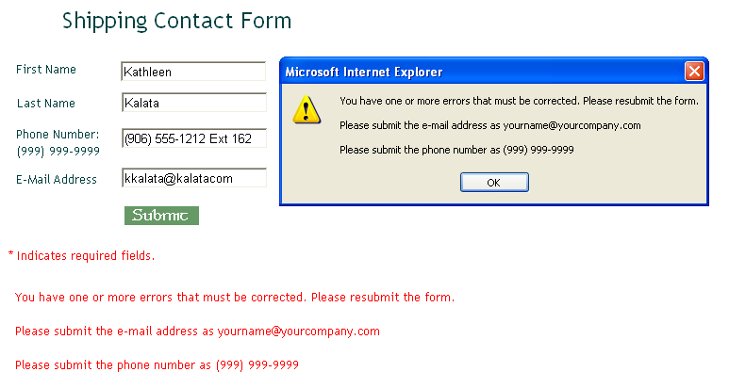
ASPValidationSummary.aspx

Slide 31
Introduction to Web Forms and Controls
ASP.NET provides features that allow you to quickly build Web Forms pages using ASP.NET controls
ASP.NET controls are similar to HTML elements for forms and controls
ASP.NET Programming with C# and SQL Server, First Edition

Slide 32
Understanding ASP.NET Web Forms and Server Controls
Web page forms are used primarily to submit user data to a server for processing
Data received by a form submission is usually a text string assigned to the Request.QueryString and Request.Form collections
JavaScript can be used to validate the form data before submission to a server-side program
  JavaScript can be bypassed by appending a query directly to the URL
ASP.NET Programming with C# and SQL Server, First Edition

Slide 33
Using Web Forms
Web forms: used to build dynamic interfaces containing Web server controls to:
  Access data sources
  Validate user input
  Handle site navigation
  Manage security issues such as logins and password recovery
  Perform other tasks
Web forms and their server controls can be controlled programmatically with ASP.NET
ASP.NET Programming with C# and SQL Server, First Edition

Slide 34
Using Web Forms (cont’d.)
default.aspx file contains a form element with this setting to specify that it is an ASP.NET Web form:
  <form runat=“server”>
Web form only submits data to itself; you cannot submit a Web form to another page
  By default, the form’s data will be posted back to the Web page itself – a process called post back
  View state: determines whether or not data is posted back to a Web page
With post back and view state, you do not need to retrieve form data with Response.QueryString or Response.Form collections
ASP.NET Programming with C# and SQL Server, First Edition

Slide 35
Using Web Forms (cont’d.)
Web server TextBox control is equivalent to <input type=“text”> HTML element
Web server Button control is equivalent to the HTML button element
Web server controls can be programmatically accessed and manipulated on the server with an ASP.NET program
  HTML elements can only be accessed and manipulated on the client with JavaScript
Web server controls all include runat=“server” attribute
ASP.NET Programming with C# and SQL Server, First Edition

Slide 36
Using Web Forms (cont’d.)
View state is maintained by assigning form values to the value attribute of a hidden form field called _VIEWSTATE
  Values are encoded with Base64, which allows nonalphanumeric characters to be included
View state is enabled by default but can be disabled in the page directive:
<%@ Page Language=“C#” EnableViewState=“false” %>
Can also be disabled in the control element’s opening tag
ASP.NET Programming with C# and SQL Server, First Edition

Slide 37
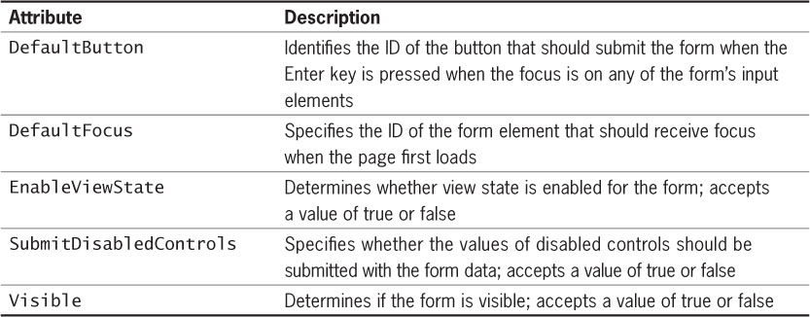
Using Web Forms (cont’d.)
Table 4-1 ASP.NET Web form attributes
ASP.NET Programming with C# and SQL Server, First Edition

Slide 38
Using Web Forms (cont’d.)
ASP.NET form attributes can be assigned on the <form> tag
  Example: <form ID=“form1” runat=“server” DefaultButton=“submitOrder”>
ASP.NET attributes can be set programmatically with C# by appending the attribute name to the control’s ID value with a period
  Example: creditCardNum.EnableViewState=“false”;
ASP.NET Programming with C# and SQL Server, First Edition

Slide 39
Using Web Forms (cont’d.)
Use the Text property of a Textbox’s ID to retrieve its current value
  Example: string shippingAddress =
  address.Text;
After the server-side program processes the data, it is returned to the same Web form page
  Use the form’s Visible attribute to hide the form and display a message indicating successful submission
Use the Page class’s IsPostBack property to determine whether a Web form has already been submitted and determine if data must be validated
ASP.NET Programming with C# and SQL Server, First Edition

Slide 40
Understanding Events
Event: a specific circumstance, such as a user action, that is monitored by the browser
  Example: when a user clicks a button, the Click event is generated, or raised
Three types of events are supported by ASP.Net:
  Application events
  Page events
  Control events
An XHTML element can be associated with a specific event to trigger code written in JavaScript, VBScript, or other client-side scripting languages
ASP.NET Programming with C# and SQL Server, First Edition

Slide 41
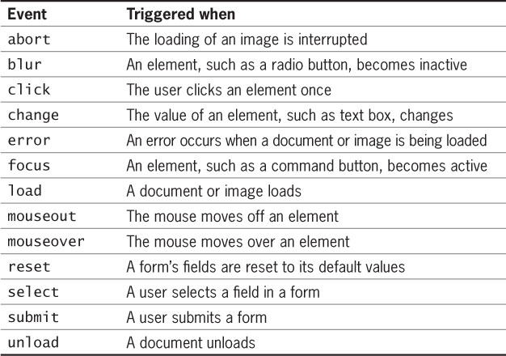
Understanding Events (cont’d.)
Table 4-2 JavaScript events
ASP.NET Programming with C# and SQL Server, First Edition

Slide 42
Writing Event Handlers
Event handler: a function or method that executes in response to a specific event
  Default name for a page event handler is Page_eventname()
  Example: Load event is Page_Load()
Event handler methods require two parameters:
  An object argument representing the raised event
  An EventArgs parameter used for passing data with an event
For page events, the parameters will not contain any values
ASP.NET Programming with C# and SQL Server, First Edition

Slide 43
Writing Event Handlers (cont’d.)
Code-behind page: preferred method for working with C# code
  Is a separate class file containing properties for an associated page
  Has a file extension of .cs
Example: the code-behind page for a Default.aspx file is Default.aspx.cs
ASP.NET Programming with C# and SQL Server, First Edition

Slide 44
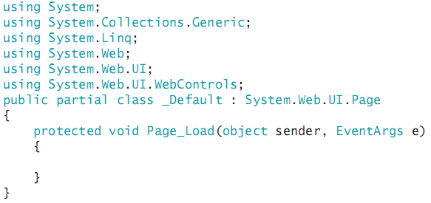
Writing Event Handlers (cont’d.)
Each code-behind page has the following code:
ASP.NET Programming with C# and SQL Server, First Edition

Slide 45
Writing Event Handlers (cont’d.)
Namespace: a container that manages identifiers in a C# program
Access specifier: determines the availability of a class’s methods and properties
  Protected access specifier only allows the class to access the method or property
Specify the name of control events as function or method name, followed by event name
  Example: calcShipping_Click
Page events are contained in the Page class
ASP.NET Programming with C# and SQL Server, First Edition

Slide 46
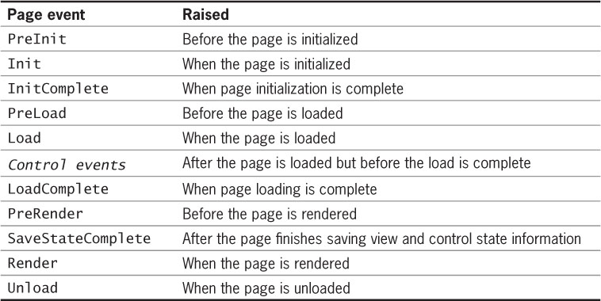
Writing Event Handlers (cont’d.)
Table 4-3 ASP.NET page events
ASP.NET Programming with C# and SQL Server, First Edition

Slide 47
Working with Control Events
With ASP.NET server controls, post back occurs every time a server control event executes
  The form is submitted every time a control event occurs
  Page events therefore execute each time a response is returned to the client
  May wish to use JavaScript for certain tasks to avoid this extra traffic to the server and back
ASP.NET Programming with C# and SQL Server, First Edition

Slide 48
What Are the Different
Types of Controls?
ASP.NET supports three types of controls:
  Server controls: special types of HTML controls that run on the server and can be programmatically accessed and manipulated by ASP.NET programs
  User controls: customized types of controls consisting of multiple server controls and HTML elements
  Web parts controls: allow users to directly control the behavior and appearance of an ASP.NET page from within the browser
ASP.NET Programming with C# and SQL Server, First Edition

Slide 49
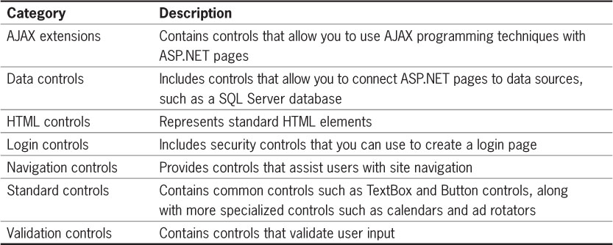
What Are the Different
Types of Controls? (cont’d.)
Table 4-4 Server control categories
ASP.NET Programming with C# and SQL Server, First Edition

Slide 50
What Are the Different
Types of Controls? (cont’d.)
Add ASP.NET controls to the form by dragging them from the Toolbox to the <form> element
  Code will be added to the Web form when you drag a control onto it
  A tag pair for the control is also added
Can also format some server controls as empty elements, with no ending tag
ASP.NET Programming with C# and SQL Server, First Edition

Slide 51
Using ASP.NET Standard Controls
Each server control has multiple methods, properties, and events
Methods, properties, and events that are common to more than one control are contained in the Control class
If a control will not need to be programmatically available to the ASP.NET program, use the equivalent HTML element instead
ASP.NET Programming with C# and SQL Server, First Edition

Slide 52
Text and Image Controls
Label control: equivalent to the HTML <label> element
  Used to set and modify text appearing on a page
<label> HTML element: associated with and appears as a label for only one form control
  accesskey attribute indicates the form control with which the label is associated
ASP.NET Label control:
  AssociatedControlID property associates it with a control
ASP.NET Programming with C# and SQL Server, First Edition

Slide 53
Text and Image Controls (cont’d.)
If the Label control has a tag pair, its contents are displayed as the label’s text
If the Label control is created as an empty element, use the Text property to specify the label’s text
Literal control: adds literal text that is not rendered in any HTML elements but can be created and manipulated programmatically on the server
  Example: can modify the contents of a Label control by manipulating a Literal control’s value
ASP.NET Programming with C# and SQL Server, First Edition

Slide 54
Text and Image Controls (cont’d.)
Image control: adds an image that is rendered with the HTML <img> element
  ImageURL property: used to identify the file associated with the image control
  AlternateText property: equivalent to the alt HTML attribute of an <img> element
  Height and Width properties: equivalent to the height and width attributes of an <img> element
Specify the height and width of an image to allow the browser to reserve space for the image and load the rest of the page while the image is being downloaded
ASP.NET Programming with C# and SQL Server, First Edition

Slide 55
Hyperlink Controls
HyperLink control: adds a hyperlink that is rendered with the HTML <a> element
  NavigateURL property: specifies the link’s target URL
  Text property: specifies the visible link text when using an empty element
  ImageURL property: to use an image as a link anchor
Image map: allows users to click on an area of an image to navigate to another page
Hot spot: each region of an image associated with a URL
ASP.NET Programming with C# and SQL Server, First Edition

Slide 56
Hyperlink Controls (cont’d.)
ImageMap control: defines the image to be used for an image map
  ImageURL property: specifies the image file to be used
To configure a hot spot within an image map, nest one of these controls within the ImageMap control:
  <asp:circlehotspot> control: a circular hot spot
  <asp:rectanglehotspot> control: a rectangular hot spot
  <asp:polygonhotspot> control: a polygon hot spot
Must specify coordinates for the shapes
ASP.NET Programming with C# and SQL Server, First Edition

Slide 57
Hyperlink Controls (cont’d.)
HotSpotMode property: determines the behavior of a hot spot:
  Inactive value: disables the hot spot
  Navigate value: causes the page to navigate to the specified URL
  NotSet value: each hot spot without a value assigned to its own HotSpotMode property navigates to its specified target URL
  Postback value: the Web form will post back to itself
ASP.NET Programming with C# and SQL Server, First Edition

Slide 58
Hyperlink Controls (cont’d.)
When using Postback value for HotSpotMode property:
  Must create a click event handler for the image map
  Requires a second parameter defined with the ImageMapEventArgs parameter
ImageMapEventArgs parameter allows you to access the PostBackValue property to identify which hot spot was clicked
ASP.NET Programming with C# and SQL Server, First Edition

Slide 59
Form Controls
Standard HTML <input> element allows you to create several types of form controls:
  Text boxes and password boxes
  Radio buttons
  Check boxes
  Push buttons, submit buttons, and reset buttons
  File boxes
  Image submit buttons
ASP.NET provides separate controls for each of these, but each is rendered with the <input> element
ASP.NET Programming with C# and SQL Server, First Edition

Slide 60
TextBox and HiddenField Controls
TextBox control: equivalent to <input type = “text”> HTML element
TextMode property: determines the behavior of the TextBox control:
  SingleLine: allows only one line of text
  MultiLine: allows multiple lines of text
  Password: text input is obscured
HiddenField control: creates a form field rendered with <input type = “hidden”>
  Value property: manipulates the value in a hidden field
ASP.NET Programming with C# and SQL Server, First Edition

Slide 61
Button, ImageButton, and LinkButton Controls
Button control: creates two types of buttons
  Submit button: causes a Web form to post back to itself (default functionality)
  Push button: similar to OK and Cancel buttons in dialog boxes
UseSubmitBehavior:
  True: specifies that this button is the submit button, rendered with <input type=“submit”> element
  False: creates a push button, rendered with <input type=“button> element
ASP.NET Programming with C# and SQL Server, First Edition

Slide 62
Button, ImageButton, and LinkButton Controls (cont’d.)‏
ImageButton control: creates an image submit button with a graphical image
  Renders with <input type=“image”> element
  ImageURL property: specifies the image to use
LinkButton control: creates a hyperlink that posts the form to the server instead of navigating to another URL
  Renders with <a> element
ASP.NET Programming with C# and SQL Server, First Edition

Slide 63
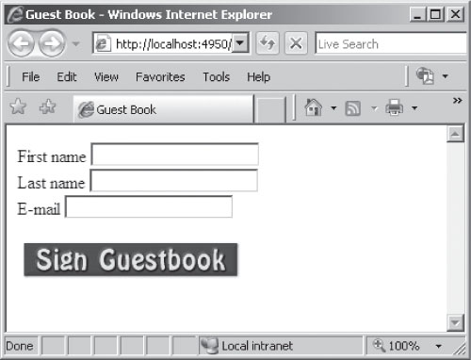
Button, ImageButton, and LinkButton Controls (cont’d.)‏
Figure 4-7 Form with an image button
ASP.NET Programming with C# and SQL Server, First Edition

Slide 64
RadioButton and RadioButtonList Controls
Radio buttons (or option buttons): groups of controls from which only one selection can be made
RadioButton or RadioButtonList controls:
  Render with <input type=“radio”/> element
  GroupName property: assigns a radio button to a specified group
  Text property: unique value associated with the button
  Checked property: indicates if the button was selected
ASP.NET Programming with C# and SQL Server, First Edition

Slide 65
RadioButton and RadioButtonList Controls (cont’d.)
RadioButtonList control: provides an easy way to organize individual radio buttons
  Nest ListItem controls within each RadioButtonList control to represent individual radio buttons
  SelectedItem property: used to determine which item was selected
ASP.NET Programming with C# and SQL Server, First Edition

Slide 66
CheckBox and CheckBoxList Controls
CheckBox control: allows multiple selections from a group of items
  Renders with <input type=“checkbox”/>
  Checked property: indicates if check box was selected
CheckedChanged event: executes when the user clicks the check box
  By default, this does not cause post back
  AutoPostBack property: value of true will cause post back to occur
ASP.NET Programming with C# and SQL Server, First Edition

Slide 67
CheckBox and CheckBoxList Controls (cont’d.)
CheckBoxList control: provides an easy way to organize multiple check boxes
  Nest ListItem controls within the CheckBoxList control to represent individual check boxes
  Items collection: used to iterate through the check boxes
  Selected property: indicates if an item was selected
  RepeatColumns property: how many columns are used to display the check boxes
ASP.NET Programming with C# and SQL Server, First Edition

Slide 68
CheckBox and CheckBoxList Controls (cont’d.)
CheckBoxList control (cont’d.):
  RepeatDirection property: determines vertical or horizontal layout
  RepeatLayout property: determines whether check box list is laid out in a table
ASP.NET Programming with C# and SQL Server, First Edition

Slide 69
ListBox and DropDownList Controls
HTML <select> element creates a fixed selection list of choices
ListBox control: creates a list of choices
DropDownList control: creates a drop-down style menu
Nest ListItem controls within these controls to represent each list item
Selected property: indicates which item was selected
ASP.NET Programming with C# and SQL Server, First Edition

Slide 70
ListBox and DropDownList Controls (cont’d.)
ListBox control properties include:
  SelectionMode: determines whether multiple items can be selected
  Rows: specifies how many list items to display
ASP.NET Programming with C# and SQL Server, First Edition

Slide 71
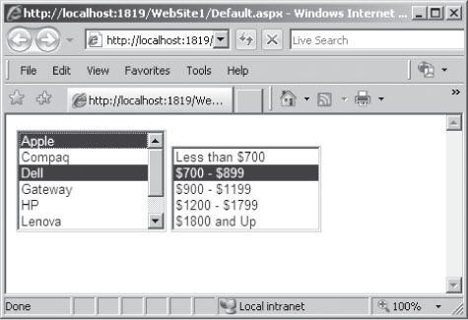
ListBox and DropDownList Controls (cont’d.)
Figure 4-8 Two selection lists
ASP.NET Programming with C# and SQL Server, First Edition

Slide 72
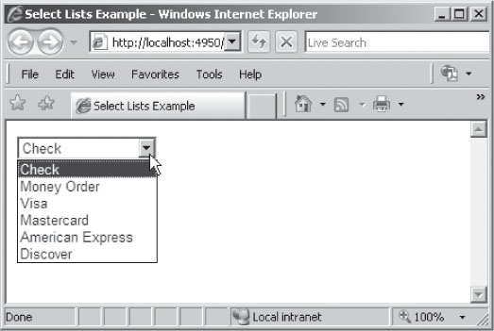
ListBox and DropDownList Controls (cont’d.)
Figure 4-9 Drop-down list
ASP.NET Programming with C# and SQL Server, First Edition

